Slide 1
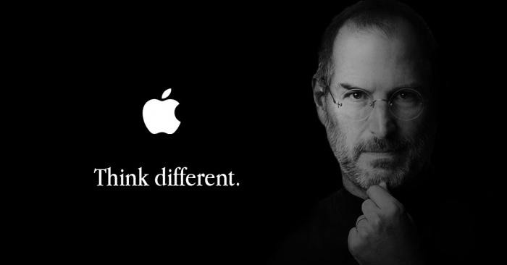

Chapter 1
Introduction to Entrepreneurship

Slide 2

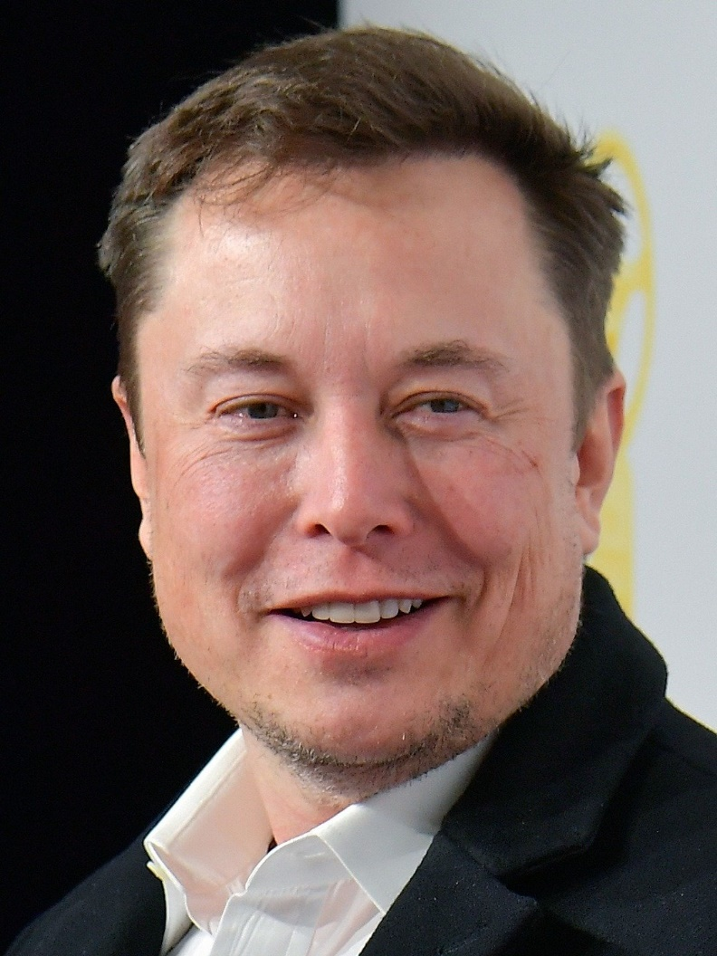
Difference between Businessman and Entrepreneur
A businessman walks on the defined path, but an entrepreneur believes in making his own path, which becomes a guideline for other businessmen.
Most of the people have a misconception that the terms businessman and entrepreneur, carry the same meaning, due to which they use them interchangeably.
Entrepreneur is always a market leader whereas a businessman is a market player.
A businessman is a person who runs the business, undertaking an unoriginal business idea. On the contrary, An entrepreneur is a person who conceives a unique idea or concept to start an enterprise and brings it into reality. He is the person who bears risks and uncertainties of the business.

Slide 3
Chapter Objectives
Explain entrepreneurship and discuss its importance.
Describe corporate entrepreneurship and its use in established firms.
Discuss three main reasons people decide to become entrepreneurs.
Identify four main characteristics of successful entrepreneurs.
Explain five common myths regarding entrepreneurship.

Slide 4
Chapter Objectives
Explain how entrepreneurial firms differ from salary-substitute and lifestyle firms.
Discuss the impact of entrepreneurial firms on economies and societies.
Identify ways in which large firms benefit from the presence of smaller entrepreneurial firms.
Explain the entrepreneurial process.

Slide 5
Introduction to Entrepreneurship
There is tremendous interest in entrepreneurship in the
U.S. and around the world.

Slide 6
Mega Entrepreneurs/Founders
Jeff Bezos – Amazon.Com
Sergey Brin & Larry Page- Google
Bill Gates & Paul Allen - Microsoft
Larry Ellison - Oracle
Steve Jobs & Steve Wozniak - Apple Computer
Michael Dell - Dell Computer
Mark Zuckerberg - Facebook
Richard Branson – Virgin Group of Comp.
Phil Knight – Nike
Akio Morita - Sony
Elon Musk – Tesla Motor, SpaceX
Walt Disney - ‎Walt Disney World ·

Slide 7
What is Entrepreneurship?
The word “entrepreneur” derives from the French words entre, meaning between,” and prendre, meaning “to take.” The word was originally used to describe people who “take on the risk” between buyers and sellers or who “undertake” a task such as starting a new venture.

Slide 8
What is Entrepreneurship?
Academic Definition (Stevenson & Jarillo)
Entrepreneurship is the process by which individuals pursue opportunities without regard to resources they currently control.
Venture Capitalist (Fred Wilson)
Entrepreneurship is the art of turning an idea into a business.
Explanation of What Entrepreneurs Do
Entrepreneurs assemble and then integrate all the resources needed –the money, the people, the business model, the strategy—needed to transform an invention or an idea into a viable business.

Slide 9
Difference between Business entrepreneurs and Social entrepreneurs?

Slide 10
Difference between Business entrepreneurs and Social entrepreneurs
Business entrepreneurs: are driven by the profit motive. They seek growth and profits within the business world. They are constant innovators and always trying to capture larger market shares from a competitive marketplace. They are pioneering individualists who create one venture after another and one innovation after another.

Slide 11
Difference between Business entrepreneurs and Social entrepreneurs
Social entrepreneurs have many of the same personality characteristics as business entrepreneurs, but they are driven by a mission and seek to find innovative ways to solve problems that are not being or cannot be addressed by either the market or the public sector.
Both business and social entrepreneurs seek innovation and growth. They thrive in both small enterprises and large organizations. They have a mind-set that separates them from the rest of the population.

Slide 12
Difference between Professionals and Entrepreneurs?

Slide 13
Corporate Entrepreneurship
Corporate Entrepreneurship
Is the conceptualization of entrepreneurship at the firm level.
All firms fall along a conceptual continuum that ranges from highly conservative to highly entrepreneurial.
The position of a firm on this continuum is referred to as its entrepreneurial intensity.

Slide 14
Corporate Entrepreneurship
Entrepreneurial Firms Conservative Firms
Proactive
Innovative
Risk taking
Take a more “wait and see” posture
Less innovative
Risk adverse

Slide 15
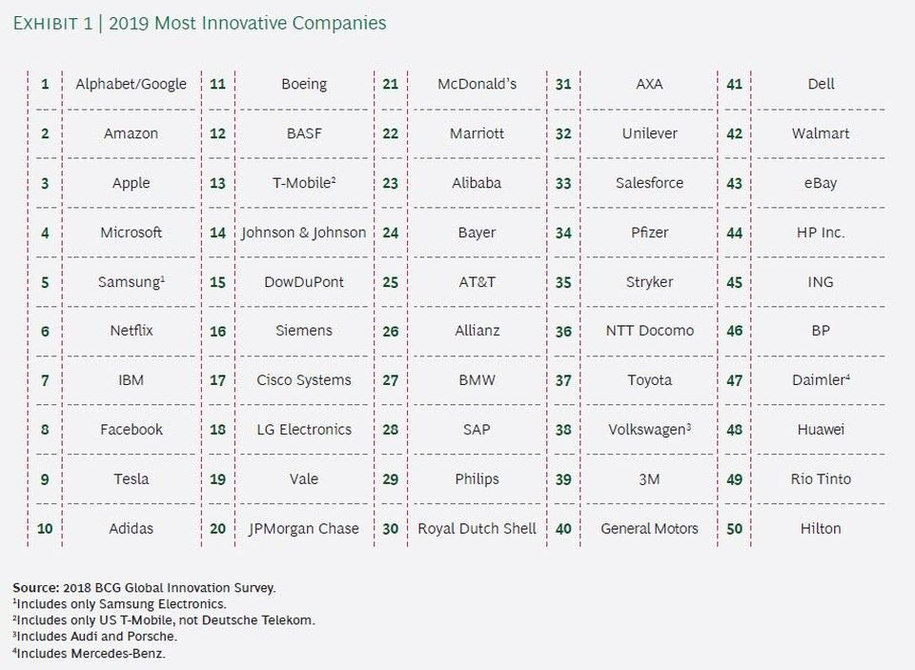
Corporate Entrepreneurship
2 of 2

Slide 16
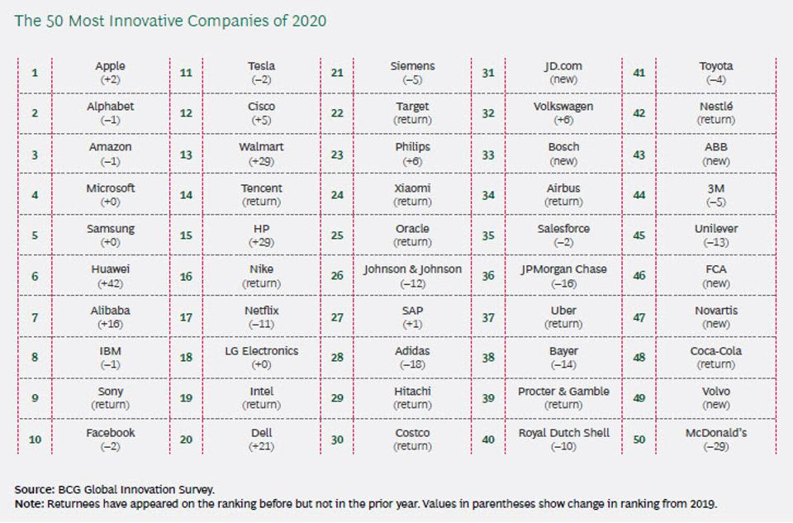
Corporate Entrepreneurship

Slide 17

Why Become an Entrepreneur?
The three primary reasons that people become entrepreneurs and start their own firms
Desire to be their own boss
Desire to pursue their own ideas
Financial rewards

Slide 18
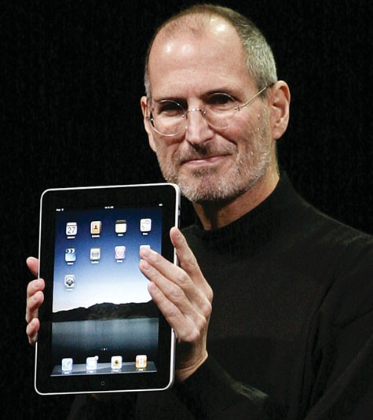
Desire to be their own boss
Steve Jobs is perhaps America’s best-known entrepreneur. He cofounded Apple Inc. in 1976, and has since built the company into a premier entrepreneurial firm. Apple’s lastest innovations include the widely popular iPhone, iPad, iPod, and Apple’s App Store and its iTunes music store.

Slide 19
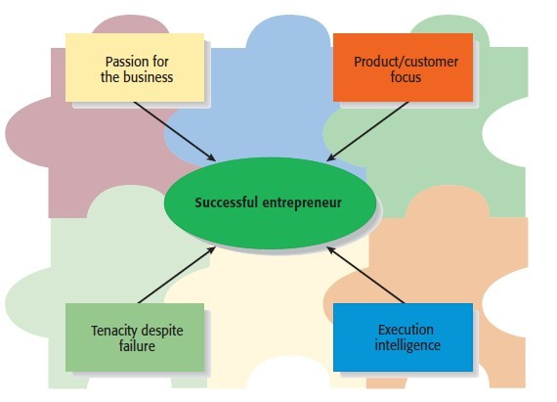
Characteristics of Successful Entrepreneurs
Four Primary Characteristics

Slide 20
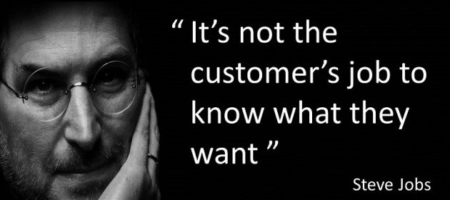
Characteristics of Successful Entrepreneurs
Passion for the Business
This passion typically stems from the entrepreneur’s belief that the business will positively influence people’s lives.
“Do what you’ve passionate about. In the startup world, if you’re bored, you might as well be dead” -
Chris Shaw, ProtechMy Photos

Slide 21
Characteristics of Successful Entrepreneurs
Product/Customer Focus
An entrepreneur’s keen focus on products and customers typically stems from the fact that most entrepreneurs are, at heart, craftspeople.
“The computer is the most remarkable tool we’ve ever built ….. but the most important thing is to get them in the hands as many people as possible.” - Steven Jobs
good products with the capability to satisfy customers.

Slide 22
Characteristics of Successful Entrepreneurs
Tenacity/Determined Despite Failure
Because entrepreneurs are typically trying something new, the failure rate is naturally high.
The process of developing a new business is somewhat similar to what a scientist experiences in the laboratory.

Slide 23
Characteristics of Successful Entrepreneurs
Execution Intelligence
The ability to fashion a solid business idea into a viable business is a key characteristic of successful entrepreneurs.
In many cases, Execution Intelligence is the factor that determines. whether a start-up is successful or fails.
The ability to execute a business idea means developing a business model, putting together’ a new venture team, raising money, establishing partnerships, managing finances, leading & motivating employees etc….
“To open a business is very easy, to keep it open is very difficult.”
- Chinese saying
“Ideas are easy. It’s execution that ‘s hard.” Jeff Bezos, Amazon.com

Slide 24
Common Myths About Entrepreneurs
Myth 1: Entrepreneurs Are Born Not Made
This myth is based on the mistaken belief that some people are genetically predisposed to be entrepreneurs.
The consensus of many studies is that no one is “born” to be an entrepreneur; everyone has the potential to become one.
Whether someone does or doesn’t become an entrepreneur, is a function of the environment, life experiences, and personal choices.

Slide 25
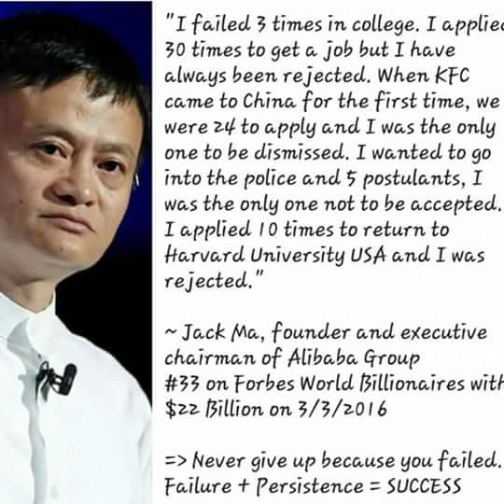
Common Myths About Entrepreneurs Entrepreneurs Are Born Not Made

Slide 26
Common Myths About Entrepreneurs
Although no one is “born” to be an entrepreneur, there are common traits and characteristics of successful entrepreneurs
Achievement motivated
Alert to opportunities
Creative
Decisive
Energetic
Has a strong work ethic
Is a moderate risk taker
Is a networker
Lengthy attention span
Optimistic disposition
Persuasive
Promoter
Resource assembler/leverager
Self-confident
Self-starter
Tenacious
Tolerant of ambiguity
Visionary

Slide 27
Common Myths About Entrepreneurs
Myth 2: Entrepreneurs Are Gamblers
Most entrepreneurs are moderate risk takers.
The idea that entrepreneurs are gamblers originates from two sources:
Entrepreneurs typically have jobs that are less structured, and so they face a more uncertain set of possibilities than people in traditional jobs.
Many entrepreneurs have a strong need to achieve and set challenging goals, a behavior that is often equated with risk taking.

Slide 28
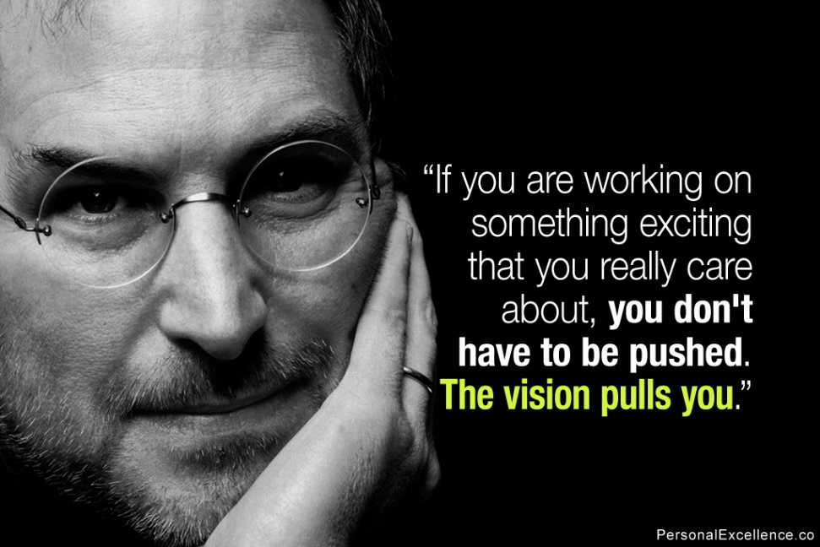
Common Myths About Entrepreneurs
Myth 2: Entrepreneurs Are Gambler.

Slide 29
Common Myths About Entrepreneurs
Myth 3: Entrepreneurs Are Motivated Primarily by Money.
While it is naïve to think that entrepreneurs don’t seek financial rewards, money is rarely the reason entrepreneurs start new firms.
In fact, some entrepreneurs warn that the pursuit of money can be distracting.

Slide 30
Common Myths About Entrepreneurs
Myth 4: Entrepreneurs Should Be Young and Energetic.
The most active age for business ownership is 35 to 45 years old.
While it is important to be energetic, investors often cite the strength of the entrepreneur as their most important criteria in making investment decisions.
What makes an entrepreneur “strong” in the eyes of an investor is experience, maturity, a solid reputation, and a track record of success.
These criteria favor older rather than younger entrepreneurs.

Slide 31

Common Myths About Entrepreneurs
Myth 4: Entrepreneurs Should Be Young and Energetic.

Slide 32
Myth 5: Entrepreneurs love the Spotlight
Indeed, some entrepreneurs are flamboyant; however, the vast majority of them do not attract public attention. In fact, many entrepreneurs, because they are working on proprietary products or services, avoid public notice.
Consider that entrepreneurs are the source of the launch of many of the 5,000 companies listed on the NASDAQ, and many of these entrepreneurs are still actively involved with their firms. But how many of these entrepreneurs can yon name? Perhaps three or four? Most of us could come up with Jeff Bezos of Amazon.com, Mark Zuckerberg of Facebook, and maybe Larry Page and Sergey Brin of Google or Larry Ellison of Oracle.

Slide 33
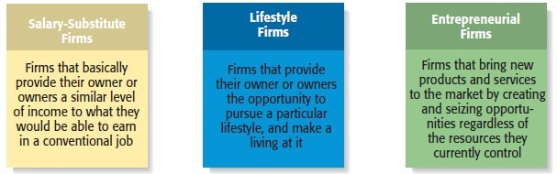
Types of Start-Up Firms

Slide 34
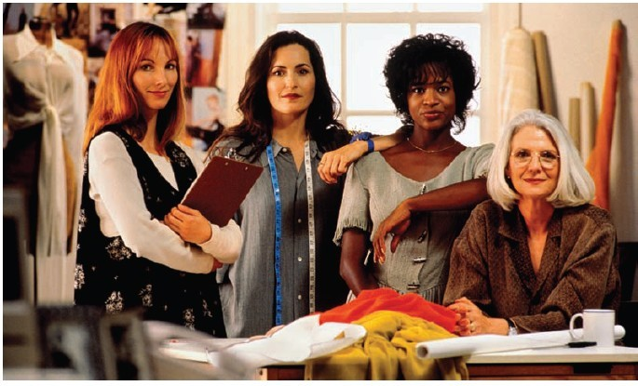
Changing Demographics of Entrepreneurs
Women Entrepreneurs
There were 6.2 million women- owned businesses in 2002 (the most recent statistics available)
This number was up 20% from 1997.

Slide 35
Changing Demographics of Entrepreneurs
Minority Entrepreneurs
Minorities owned roughly 18% of U.S. businesses in 2002.
This number was up 10% from 1997.
Senior Entrepreneurs
Although statistics are not kept on senior entrepreneurs, there is strong evidence that the number of older people choosing entrepreneurial careers is rapidly increasing.

Slide 36
Changing Demographics of Entrepreneurs
3 of 3
Young Entrepreneurs
Interest among young people in entrepreneurial careers is growing.
According to a Gallop study, 7 out of 10 high school students want to start their own business.
Over 2,000 two-year and four-year colleges and universities offer entrepreneurship courses.

Slide 37
Economic Impact of Entrepreneurial Firms
Innovation
Is the process of creating something new, which is central to the entrepreneurial process.
Small firms are twice as innovative per employee as large firms.
Job Creation
In the past two decades, economic activity has moved in the direction of smaller entrepreneurial firms, which may be due to their unique ability to innovate and focus on specialized tasks.

Slide 38
Entrepreneurial Firms’ Impact on Society and Larger Firms
Impact on Society
The innovations of entrepreneurial firms have a dramatic impact on society.
Think of all the new products and services that make our lives easier, enhance our productivity at work, improve our health, and entertain us in new ways.
Impact on Larger Firms
Many entrepreneurial firms have built their entire business models around producing products and services that help larger firms become more efficient and effective.

Slide 39
The Entrepreneurial Process
The Entrepreneurial Process Consists of Four Steps Step 1: Deciding to become an entrepreneur.
Step 2: Developing successful business ideas.
Step 3: Moving from an idea to an entrepreneurial firm. Step 4: Managing and growing the entrepreneurial firm. Step 5: Exiting the venture.

